Slide 1
Economic and Political Indicators & the Unemployment Rate 1989 - 2016
Sumi Choudhury
Carlos Tabernilla

Slide 2
Unemployment in the US
US Dept of Labor (Bureau of Labor Statistics) began gathering data in the 1940’s
Has varied as low as 1% WWI as high as 25% Great Depression
Has an inverse relationship to the economy
Thus responds to both fiscal and monetary policy
Federal Reserve has a mandate to achieve full employment while maintaining a low rate of inflation
Topic of political debate (Liberals government action & Conservatives free market solutions)
Who is unemployed?
Do not have a job – have looked in the last 4 weeks – are available to work
Workers expecting to be recalled from layoff
Link: https://en.wikipedia.org/wiki/Unemployment_in_the_United_States

Slide 3
Three Main Types of Unemployment

Slide 4
Frictional Unemployment
Is defined as the unemployment that occurs because of people moving or changing occupations
Demographic change can also play a role in this type of unemployment since young or first-time workers tend to have higher-than-normal turnover rates as they settle into a long-term occupation
An important distinguishing feature of this type of unemployment, unlike the two that follow it, is that it is voluntary on the part of the worker

Slide 5
Cyclical Unemployment
Is defined as workers losing their jobs due to business cycle fluctuations in output, i.e. the normal up and down movements in the economy as it cycles through booms and recessions over time
It occurs when the gross domestic product (GDP) falls and the economy enters a phase of contraction
Cyclical unemployment is caused by the lack of demand that is a consequence of business cycle downturns

Slide 6
Structural Unemployment
Is defined as unemployment arising from technical change such as automation, or from changes in the composition of output due to variations in the types of products people demand
For example, a decline in the demand for typewriters would lead to structurally unemployed workers in the typewriter industry
Seasonal unemployment is actually a type of structural unemployment, as the structure of the economy changes on a seasonal basis and demand for workers changes accordingly
Unlike cyclical unemployment, seasonal unemployment occurs on a more or less fixed and predictable basis, as it is caused by shifts in demand that depend on the time of year

Slide 7
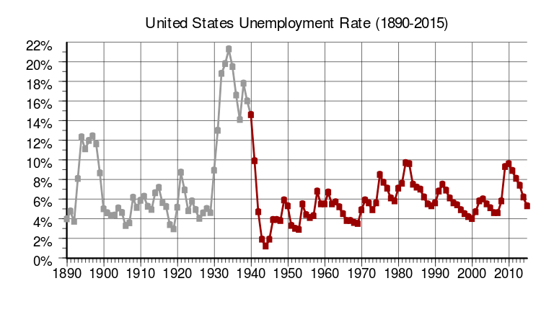
Unemployment 1890 - 2010
Source: Wikipedia

Slide 8
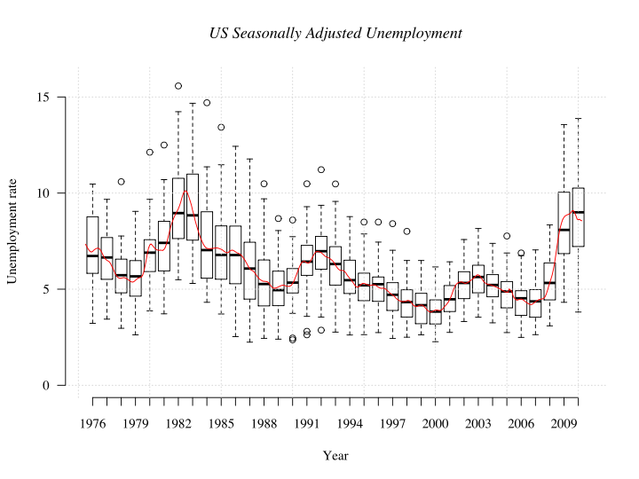
History of Fifty States Unemployment Seasonally Adjusted
Source: Bureau of Labor Statistics

Slide 9
Reason for Researching this Topic
Initially, we sought out to research Economic and Political Indicators which affect the S&P 500 American Stock Market Index
We used predictor variables such as GDP, Consumer Price Index, Consumer Sentiment, Trade Balance, Dollar, Oil, 10 Year Yield, Truck Sales, Private Construction, Presidential Party & Seasonality
Source: Reuters EIKON

Slide 10
Explanatory Variables
Economic Indicators
Interest Rates
Commodities
Currencies
Political Parties in Office
Sources
BLS, ECB, Thompson Reuters, Oxford Economics, The Conference Board, U.S. Census, University of Michigan

Slide 11
Issues in Predicting S&P 500
After a series of steps in running our regression model, by checking the assumptions and conducting all necessary transformations to our dependent and predictor variables, we found that the assumptions were not strong
It appeared to be a weak model
We believe that the strong autocorrelation presented in our data made it very difficult to isolate the true impact which our predictor variables had on our dependent variable, the S&P 500 index

Slide 12
Issues in Predicting S&P 500
Linearity, Constant Variance, and Normality - Violated
Performed Log Transformations – Assumptions remained violated
Observed Scatter Plot Matrix; Observed high multicollinearity amongst predictor variables
Discovered strong relationships between Unemployment rate amongst other X variables

Slide 13
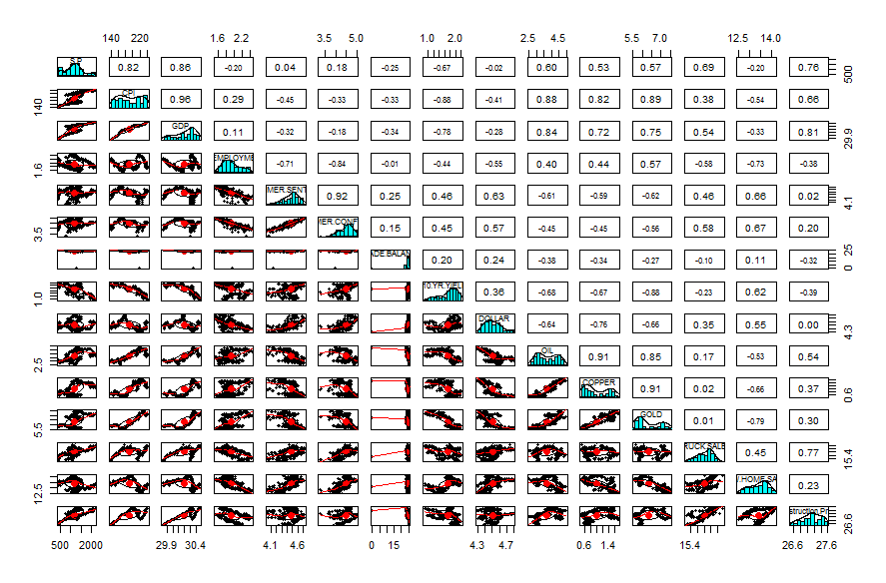
Correlation between S&P 500 and Predictor Variables

Slide 14
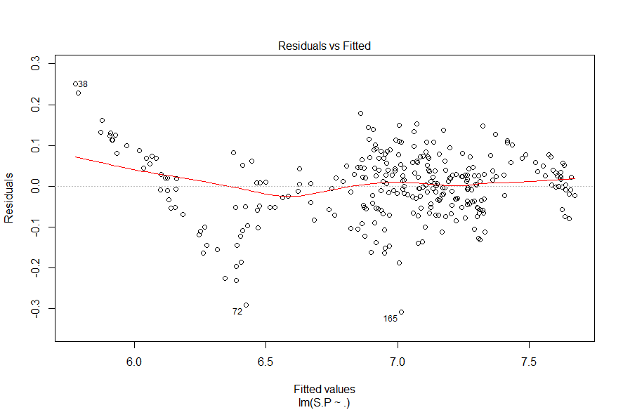
S&P 500 Log Transformed

Slide 15
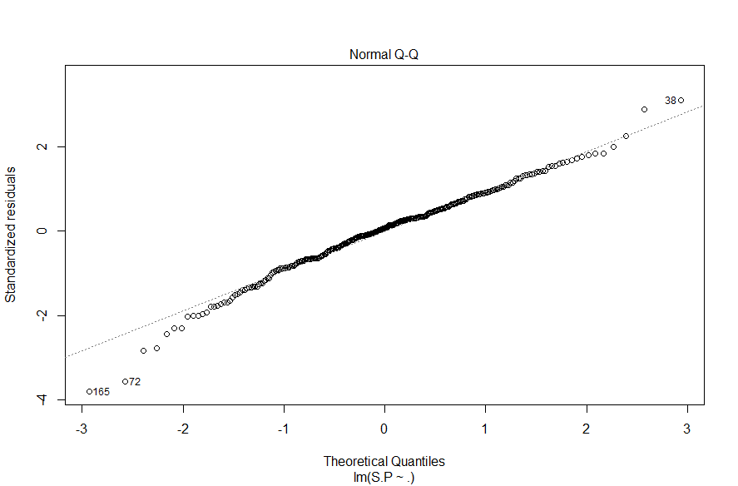
S&P 500 Log Transformed

Slide 16
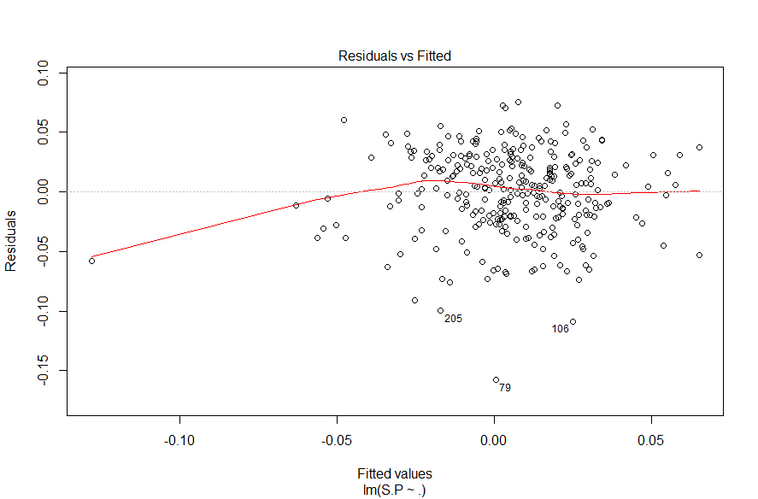
S&P 500 Log & Differencing

Slide 17
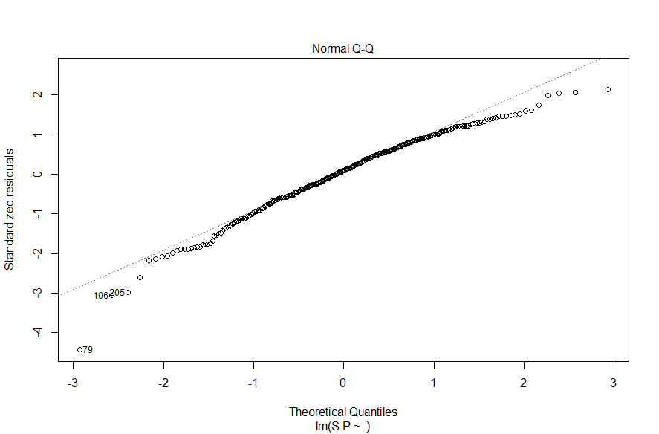
S&P 500 Log & Differencing

Slide 18
Predicting Unemployment
Explanatory Variables remain the same
Unemployment is a key figure to health of the economy
Understanding drivers of employment – helps understand drivers of economy
Economy and Unemployment have an inverse relationship
How will Republican (President/House/Senate) fair?

Slide 19
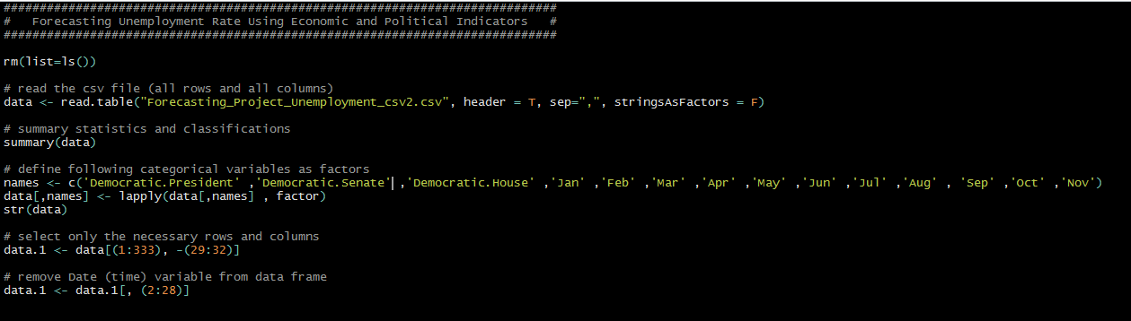
Arriving to Data Set

Slide 20

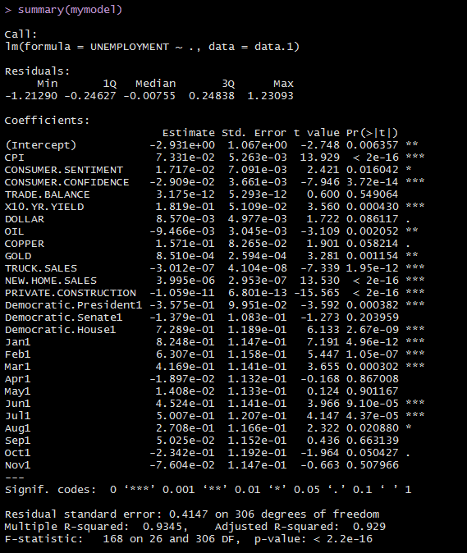
First Model
Coefficients (difficult to interpret)
P Values
R ^2 (meaningless)
* We observe plots to see if assumptions have been met

Slide 21
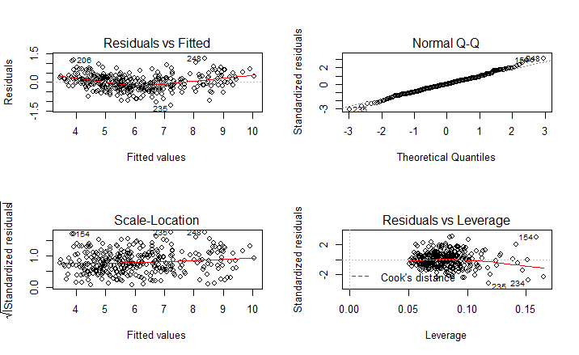
Assumptions violated
First Model
Linear relationship
Multivariate normality
No or little multicollinearity
No auto-correlation
Homoscedasticity
Plot #1: Relationship appears non-linear
Plot#2: Residuals look ok, indication of fat tails
Plot #3: Residuals are spread fairly evenly
Plot#4: None of the outliers are outside Cook’s distance of 0.5
Link: http://www.statisticssolutions.com/assumptions-of-multiple-linear-regression/
Link: http://data.library.virginia.edu/diagnostic-plots/

Slide 22
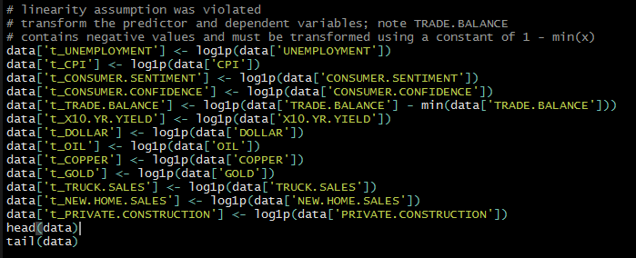
Log Transformation
Transforming x values appropriate when non-linearity is the only problem
Transforming y values appropriate when non-normality and/or unequal variances are problems
Transforming x and y – when everything seems wrong – not linear – errors not normal – unequal variances
Link: https://onlinecourses.science.psu.edu/stat501/node/318

Slide 23

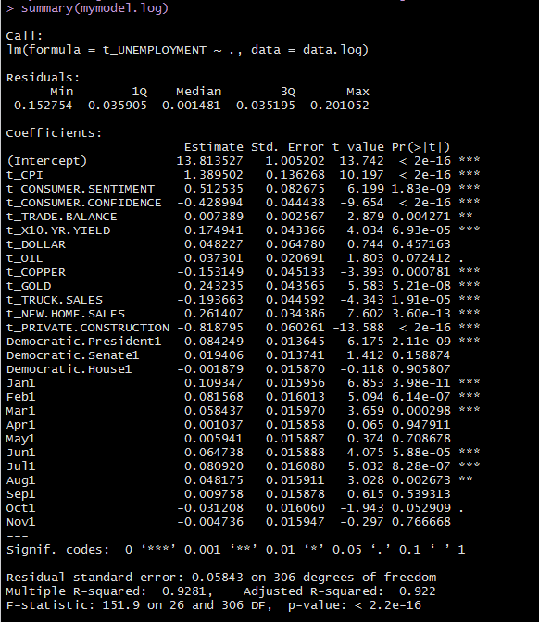
First Log Model
Coefficients (make more sense – some still question logic)
Example: Consumer sentiment and Consumer Confidence (similar) should have same signs?
P Values
R ^2 (meaningless)
* We observe plots to see if assumptions have been met

Slide 24
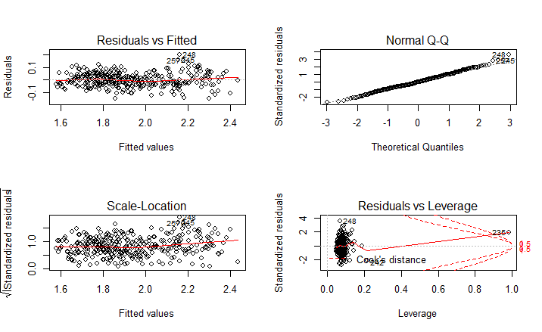
Assumptions Improved
Log Model
Linear relationship
Multivariate normality
No or little multicollinearity
No auto-correlation
Homoscedasticity
Plot #1: Relationship appears linear
Plot#2: Residuals are normally distributed
Plot #3: Residuals are spread fairly evenly
Plot#4: Observation 235 is outside Cook’s distance of 0.5

Slide 25
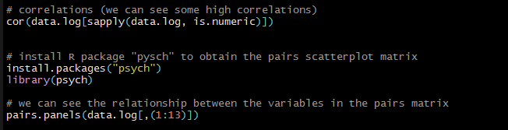
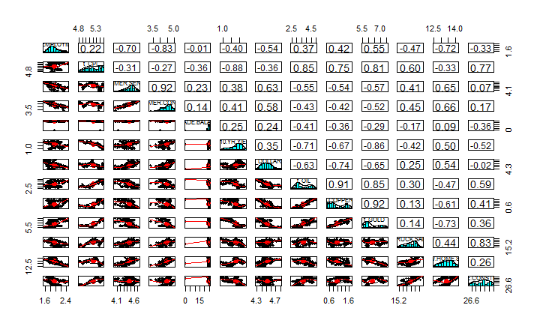
Misinterpretation – Multi collinearity
Log Model
Problems:
Can increase variance of coefficient estimates
Estimates can be sensitive to minor changes in model
Coefficients unstable and difficult to interpret
Should we fix it?
Can make choosing predictors difficult
It doesn’t affect the fit of the model
How do we look for it?
Pairs scatter plot matrix
Link: http://blog.minitab.com/blog/adventures-in-statistics/what-are-the-effects-of-multicollinearity-and-when-can-i-ignore-them

Slide 26
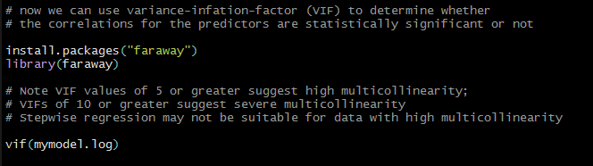
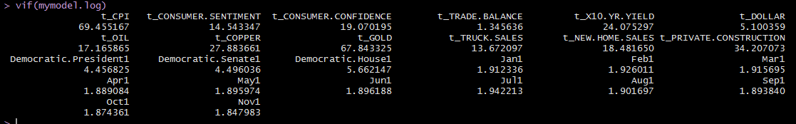
Variance Inflation Factors (VIF)
Log Model
To what extent multicollinearity is present in regression analysis
VIF = 1 Not Correlated
1< VIF <5 Moderately Correlated
VIF>=5 to 10 Highly Correlated
Suitable:
Trade Balance
Dem President
Dem Senate
Dem House
Seasonality
Link: http://support.minitab.com/en-us/minitab/17/topic-library/modeling-statistics/regression-and-correlation/model-assumptions/what-is-a-variance-inflation-factor-vif/

Slide 27
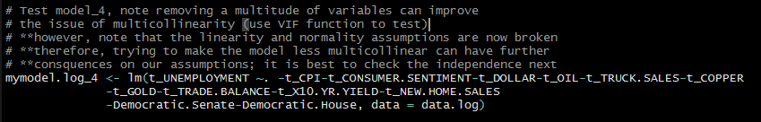
Running Partial Models – to find best fit
Partial models: We learned – fix multicollinearity – but could jeopardize linearity and normality

Slide 28
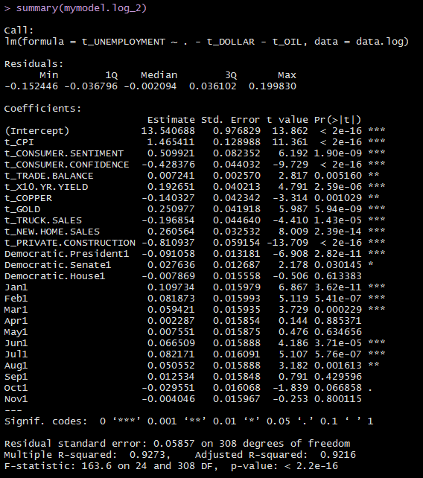

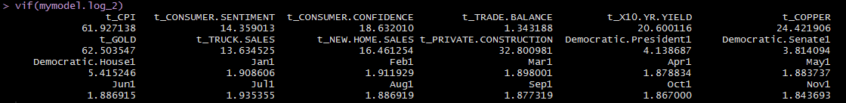
Model Log 2 Remove Dollar & Oil Improvement in VIF Factors Maintaining R^2 Assumptions still hold

Slide 29
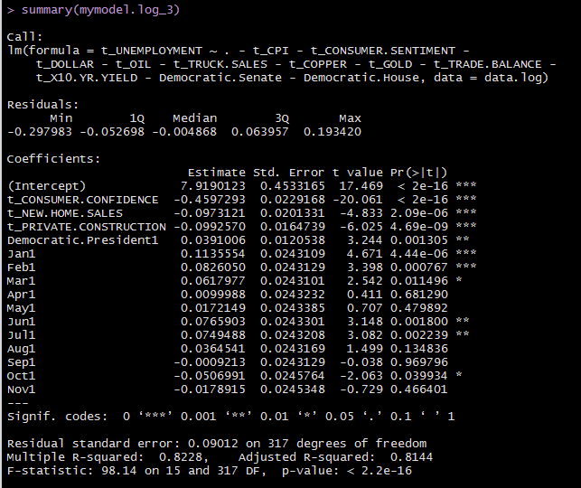
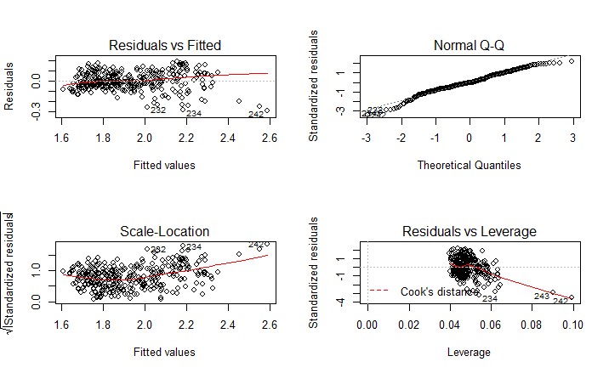
Model Log 3 Keep Consumer Confidence New Home Sales Private construction Dem Pres & Seasonality Significant improvement in VIF Factors R^2 reduced but still strong Now assumptions are broken

Slide 30
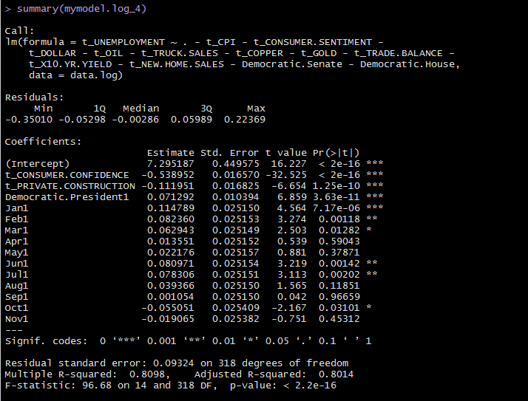
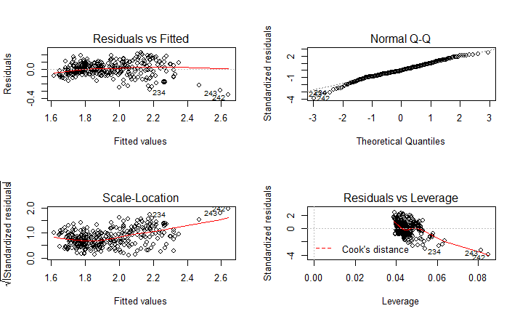
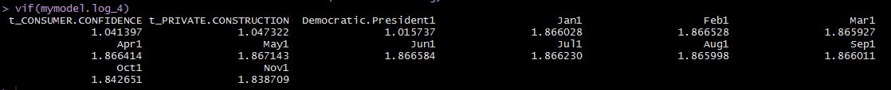
Model Log 4
Keep Consumer Confidence Private Construction Dem Pres & Seasonality
VIF Factors similar to Model Log 3 R^2 in line with Model Log 3 Assumptions continue broken

Slide 31
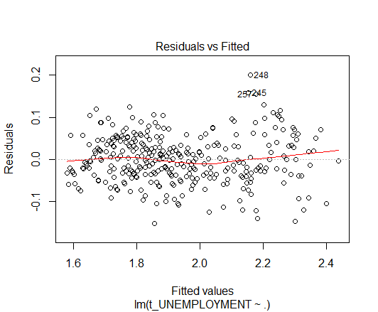

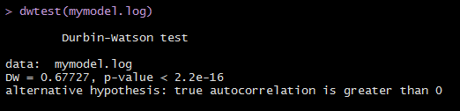
Assumption #4 Independence (Autocorrelation)
Errors Plot – Residuals look Ok
DW Test:
P < Alpha = Rho > 0 = Autocorrelation Exists
DW <2 = Positive serial correlation
Consequences?
Positive serial correlation deflates the size of the standard error.
Observed t values will be too large
Leads one to reject null hypothesis
Link: https://www1.udel.edu/htr/Statistics/Notes816/class20.PDF
Link: http://www.tc.umn.edu/~ryoox001/images/DurbinWatson_test.pdf

Slide 32
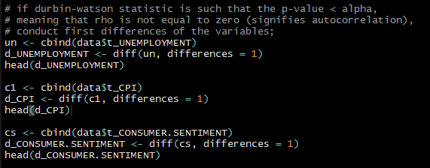
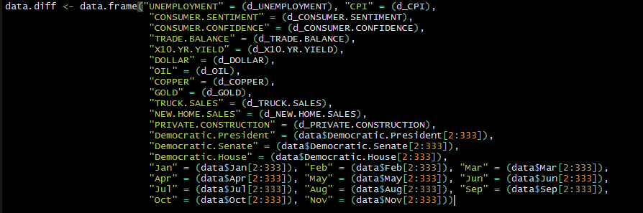
Adjusting for autocorrelation (positive serial correlation)
We take the first differences Failure to do so:
Overstated R^2
Fit will be exaggerated
Variances will be biased
Link: https://www1.udel.edu/htr/Statistics/Notes816/class20.PDF

Slide 33
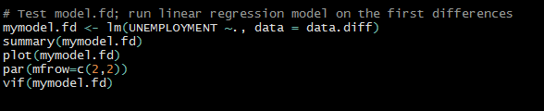
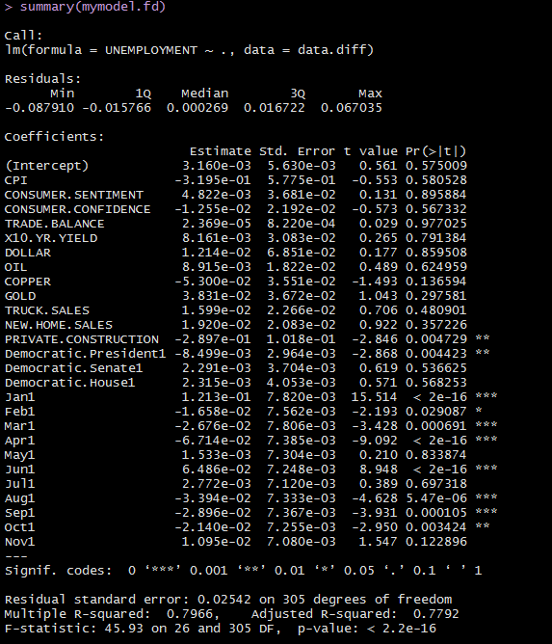
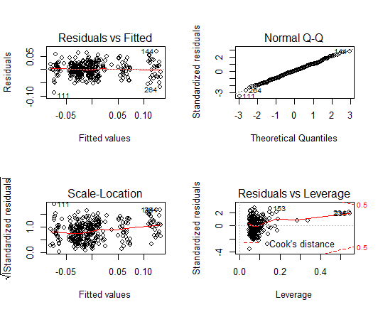
Model First Differences

Slide 34
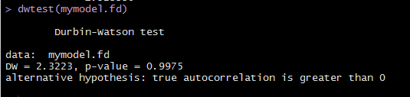
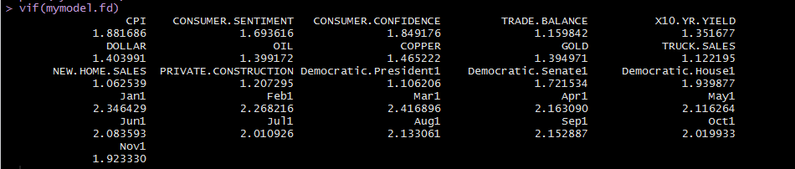
R^2 = 80% VIF all under 5 DW = 2.32 No Serial Correlation P > .05 = rho = zero no autocorrelation
Model First Differences

Slide 35
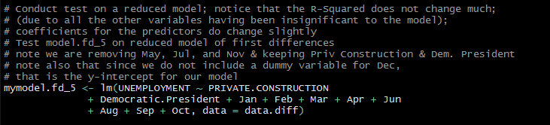


Running Partial First Differences Models – to find best fit

Slide 36
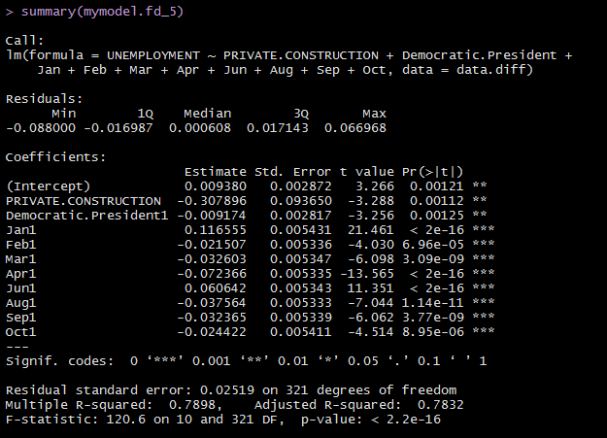
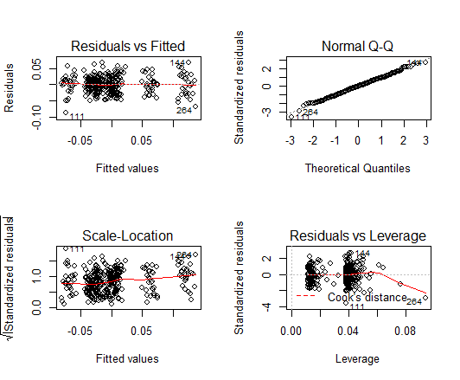

Model FD 5 Removed insignificant variables
R^2 & coefficients remain almost same

Slide 37
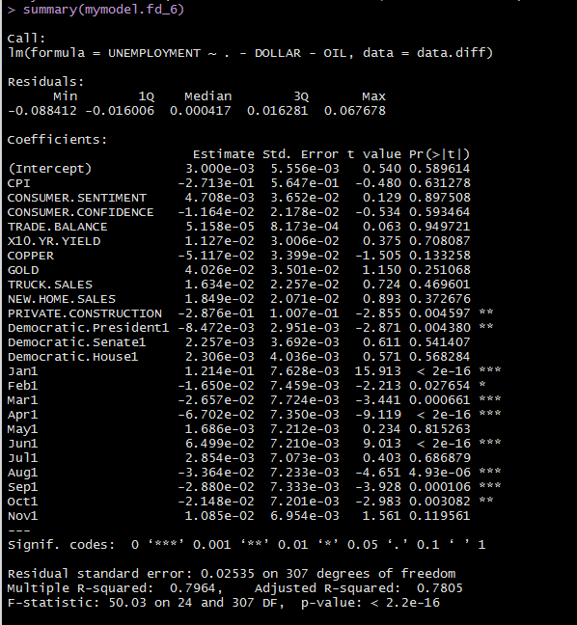
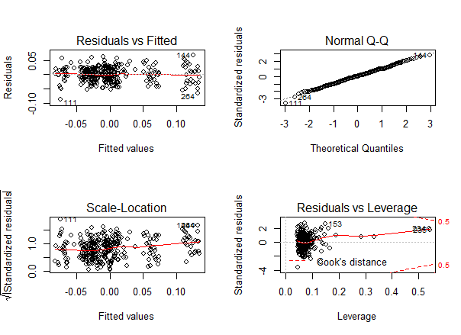

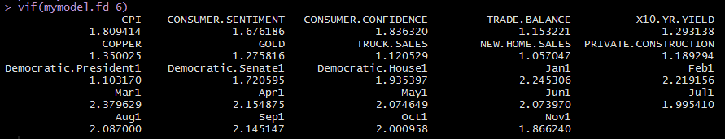
Model FD 6 Removed only Oil & Dollar
R^2 and coefficients remain almost same

Slide 38
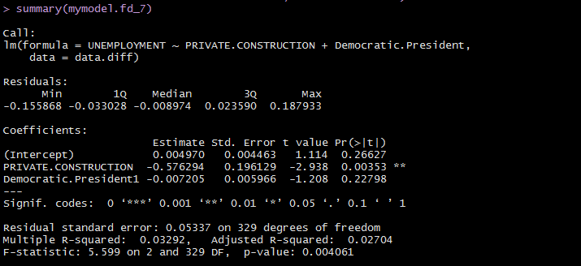
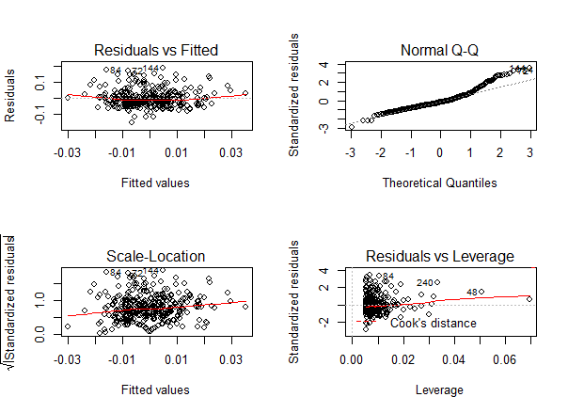

Model FD 7 Removing seasonal dummy variables
R^2 declines to 3%!
Indicating significance of seasonality

Slide 39
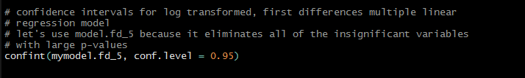
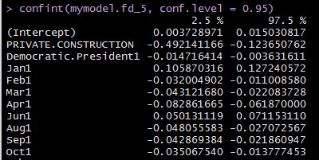
Confidence Interval
Log Transformed
First Differences

Slide 40
Empirical Evidence: Okun’s Law: Unemployment & GDP
Arthur Okun published his findings in the early 1960’s
Statistical relationship between unemployment rate and growth rate of the economy
The underlying belief, “Output depends on the amount of labor used in the production process, so there is a positive relationship between output and employment (and thus a negative relationship between output and unemployment)
Fed Reserve Chairman, Ben Bernake, “… because ongoing increases in the size of the labor force and in the level of productivity, real GDP growth close to the rate of growth of its potential is normally required, just to hold the unemployment rate steady. To reduce the unemployment rate, therefore the economy must grow at a pace above its potential.”
Findings: Okun’s law has stated very simply that a one point increase in the unemployment rate is associated with two percentage points of negative growth in GDP
Link: http://www.investopedia.com/articles/economics/12/okuns-law.asp

Slide 41
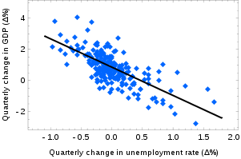
Okun’s Law
Source: Wikipedia

Slide 42
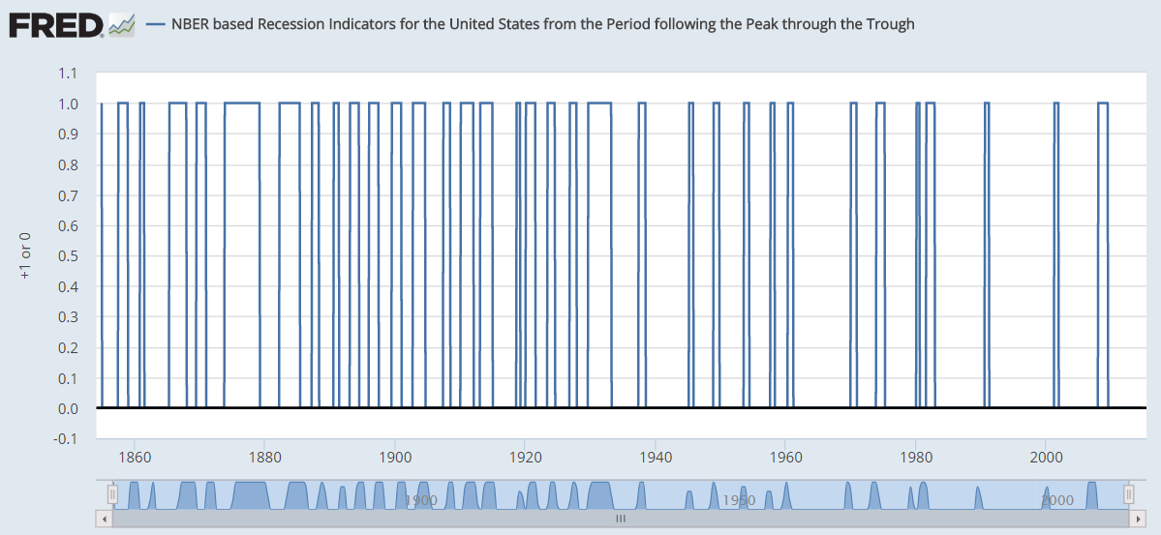
Accounting for US Business Cycle Expansions
Data from NBER (National Bureau of Economic Research)
Interpreted by FRED (Federal Reserve Bank of St. Louis)
Dummy variables represent periods of expansion and recession
Value of 1 is a recessionary period
Value of 0 is an expansionary period
Link: http://www.nber.org/cycles/cyclesmain.html
Link: https://fred.stlouisfed.org/series/USREC

Slide 43

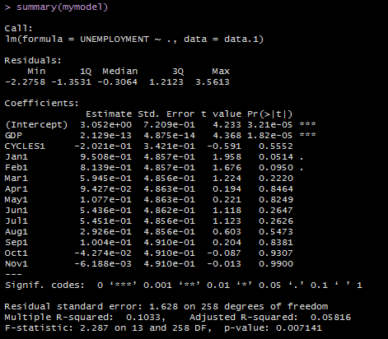
First Model
Coefficients (GDP should be negative)
R^2 .10
* We observe plots to see if assumptions have been met

Slide 44
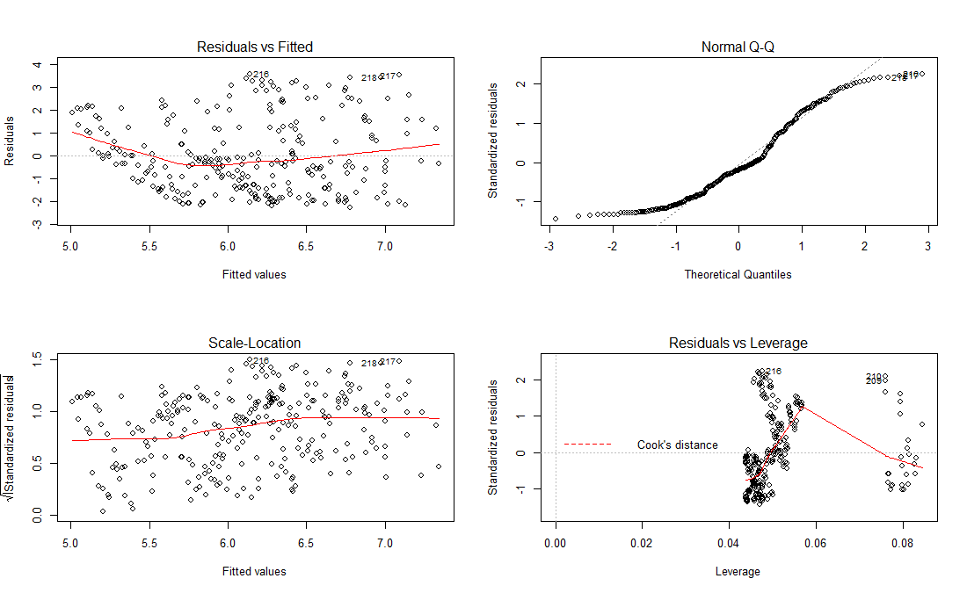
Assumptions violated
First Model
Linear relationship
Multivariate normality
No or little multicollinearity
No auto-correlation
Homoscedasticity
Plot #1: Relationship appears non-linear
Plot#2: Normal distribution skewed
Plot #3: Residuals are spread fairly evenly
Plot#4: Does not appear that our outliers affect results of the regression
Link: http://www.statisticssolutions.com/assumptions-of-multiple-linear-regression/
Link: http://data.library.virginia.edu/diagnostic-plots/

Slide 45

Log Transformation
Transforming x values appropriate when non-linearity is the only problem
Transforming y values appropriate when non-normality and/or unequal variances are problems
Transforming x and y – when everything seems wrong – not linear – errors not normal – unequal variances
Link: https://onlinecourses.science.psu.edu/stat501/node/318

Slide 46

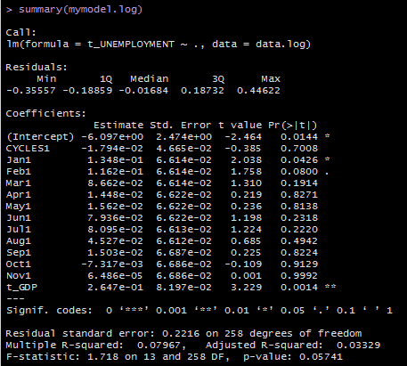
Log Model
Coefficients are still not logical (GDP/Unemployment inverse relationship)
R ^2 is worse! @ .07
* We observe plots to see if assumptions have been met

Slide 47
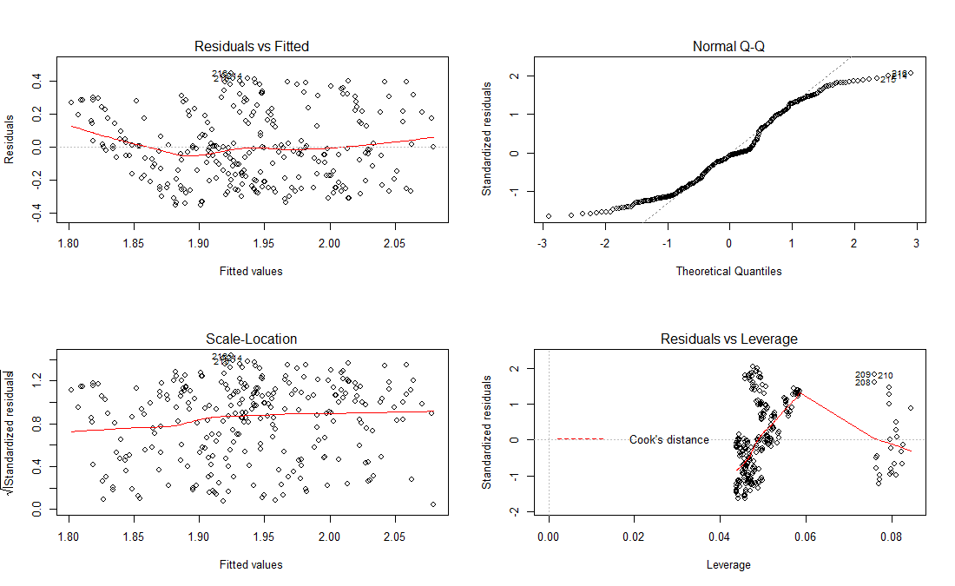
Assumptions violated
Log Model
Linear relationship
Multivariate normality
No or little multicollinearity
No auto-correlation
Homoscedasticity
Plot #1: Relationship appears non-linear
Plot#2: Normal distribution has worsened
Plot #3: Residuals are spread fairly evenly
Plot#4: Does not appear that our outliers affect results of the regression
Link: http://www.statisticssolutions.com/assumptions-of-multiple-linear-regression/
Link: http://data.library.virginia.edu/diagnostic-plots/

Slide 48



Test for Multi collinearity
Log Model
Problems:
Can increase variance of coefficient estimates
Estimates can be sensitive to minor changes in model
Coefficients unstable and difficult to interpret
No Multi collinearity present
How do we look for it?
Pairs scatter plot matrix
VIF
Link: http://blog.minitab.com/blog/adventures-in-statistics/what-are-the-effects-of-multicollinearity-and-when-can-i-ignore-them

Slide 49




Assumption #4 Independence (Autocorrelation)
Errors Plot – Residuals look Ok
DW Test:
P < Alpha = Rho > 0 = Autocorrelation Exists
DW <2 = Positive serial correlation
Consequences?
Positive serial correlation deflates the size of the standard error.
Observed t values will be too large
Leads one to reject null hypothesis
We take the first differences Failure to do so:
Overstated R^2
Fit will be exaggerated
Variances will be biased
Link: https://www1.udel.edu/htr/Statistics/Notes816/class20.PDF
Link: http://www.tc.umn.edu/~ryoox001/images/DurbinWatson_test.pdf

Slide 50



- R^2 = 80% - VIF all under 5 - DW = 2.47 No Serial Correlation - P > .05 = rho = zero no autocorrelation - Plots much improved with linearity and normality - Still no outliers affecting the results of the residuals
Model First Differences

Slide 51


Confidence Interval
First Differences

Slide 52
Interpretation (GDP)
In instances where both the dependent variable and independent variable(s) are log-transformed variables, the relationship is commonly referred to as elastic in econometrics. In a regression setting, we'd interpret the elasticity as the percent change in y (the dependent variable), while x (the independent variable) increases by one percent.
Our interpretation of chosen model with x predictor variables and y response variable:
Holding all else constant, each positive 1% change in GDP, on average, results in a negative 0.035% change in the Unemployment Rate

Slide 53
Interpretation (Cycles)
In such models where the dependent variable has been log-transformed and the predictors have not, the format for interpretation is that the dependent variable changes by 100*(coefficient) percent for a one unit increase in the independent variable while all other variable in the model are held constant.
Our interpretation of chosen model with x predictor variables and y response variable:
Holding all else constant, for each recession cycle, on average, Unemployment Rate has a positive 100*(.03) or 3% change

